Slide 1
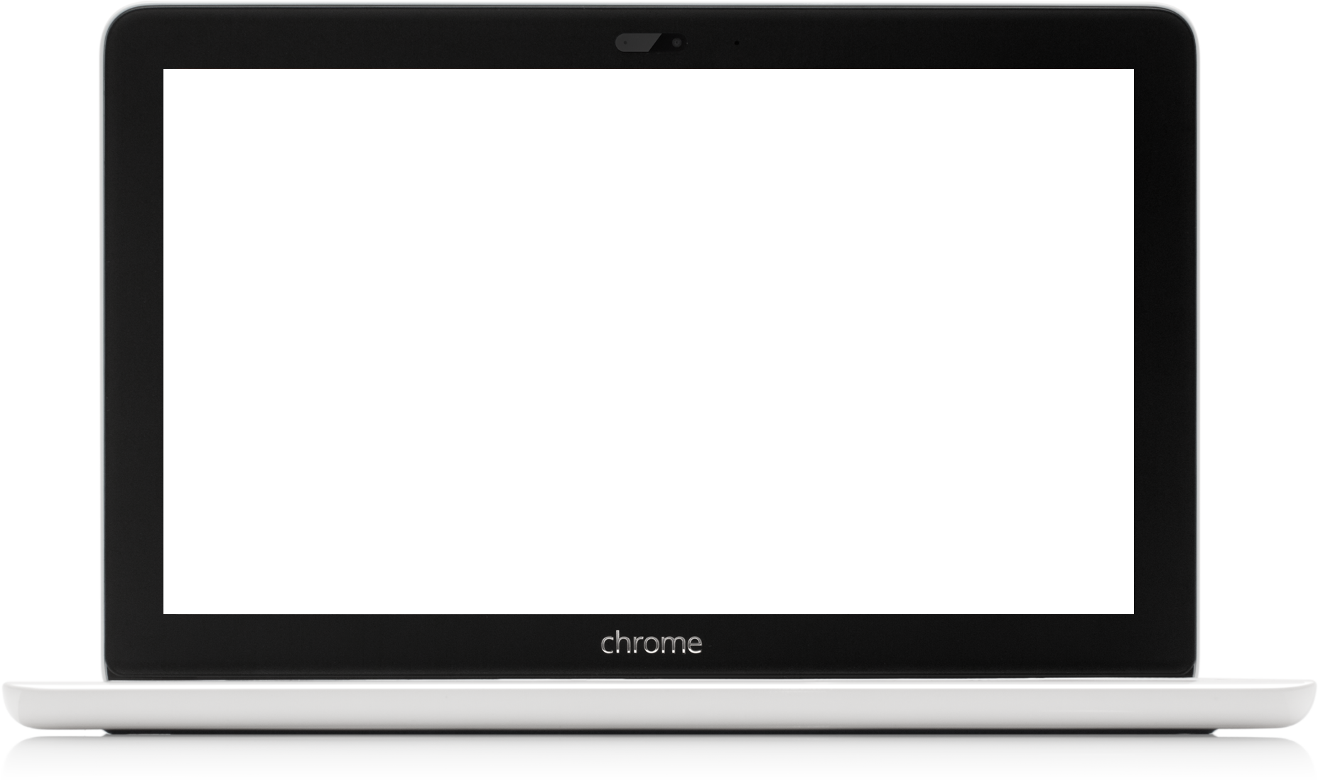
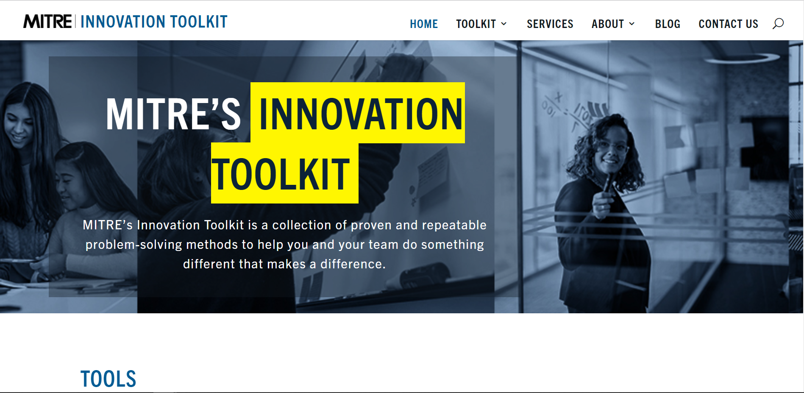
Final Presentation
Abu Batjargal
Sarah Cheung
Alex Jin
Alexandra McElhoe
Prototype Link

Slide 2
Objective
Digitize the MITRE Innovation Toolkit (ITK) to enable remote multi-user real-time collaboration and promote innovation across teams
Specific Goals
Versatile user experience
Inclusive of different personas & work styles
Synthesize multiple tools into projects & blueprints

Slide 3
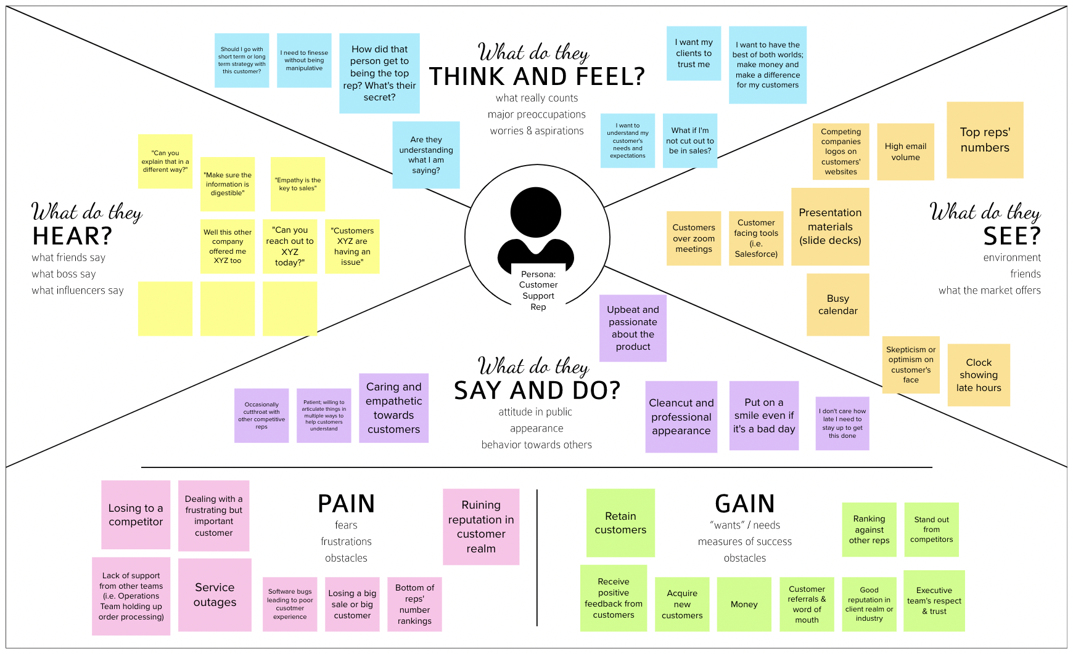
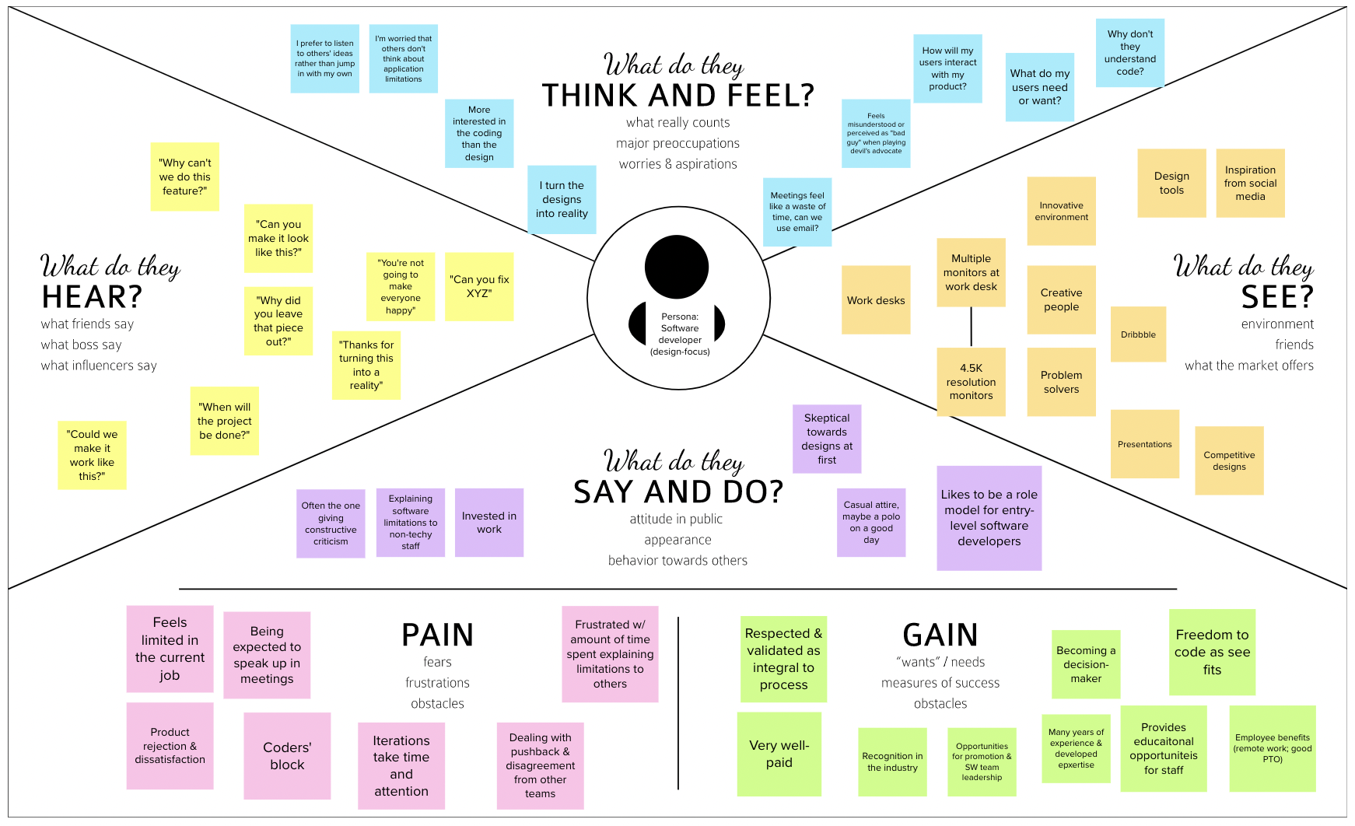
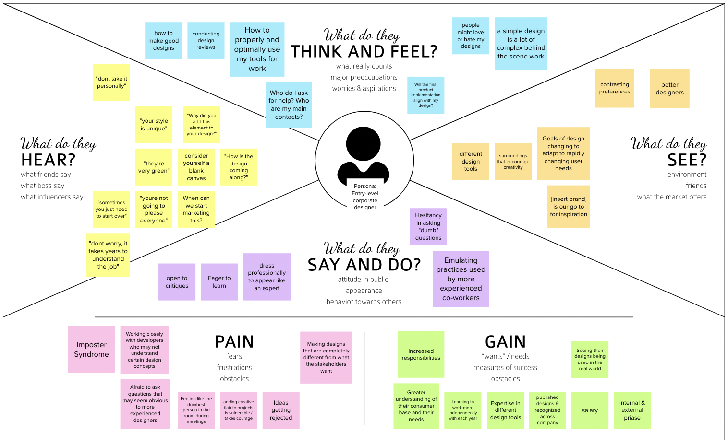
Initial Stages
Empathy Maps

Slide 4
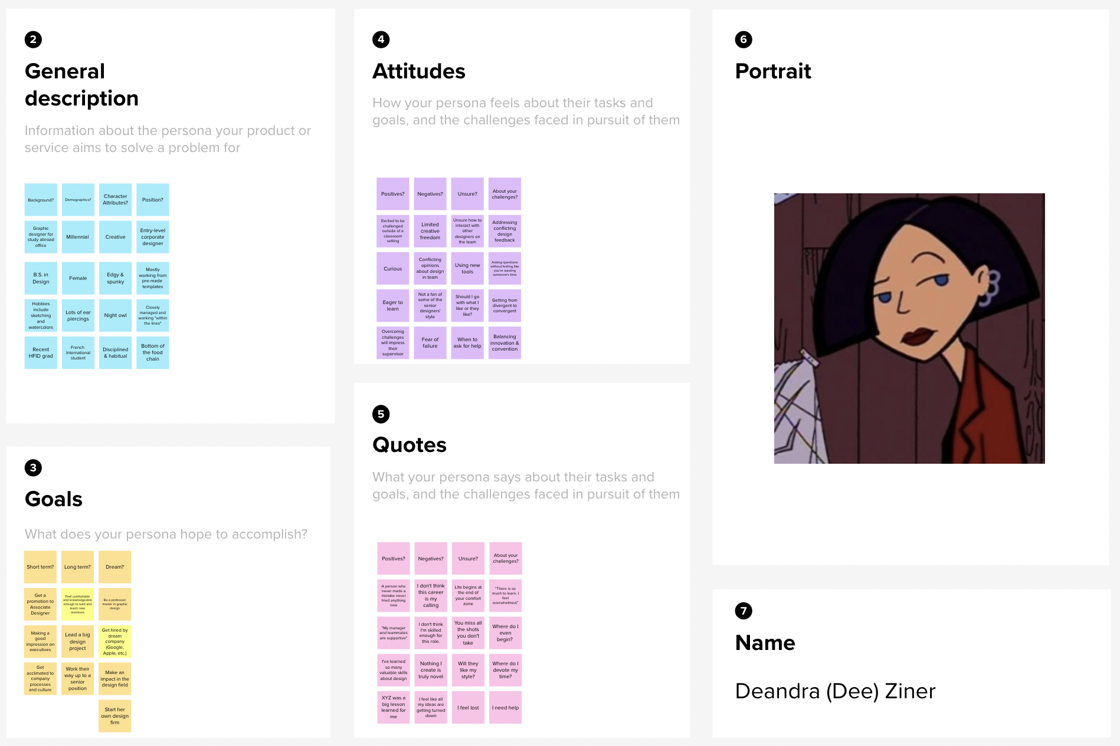
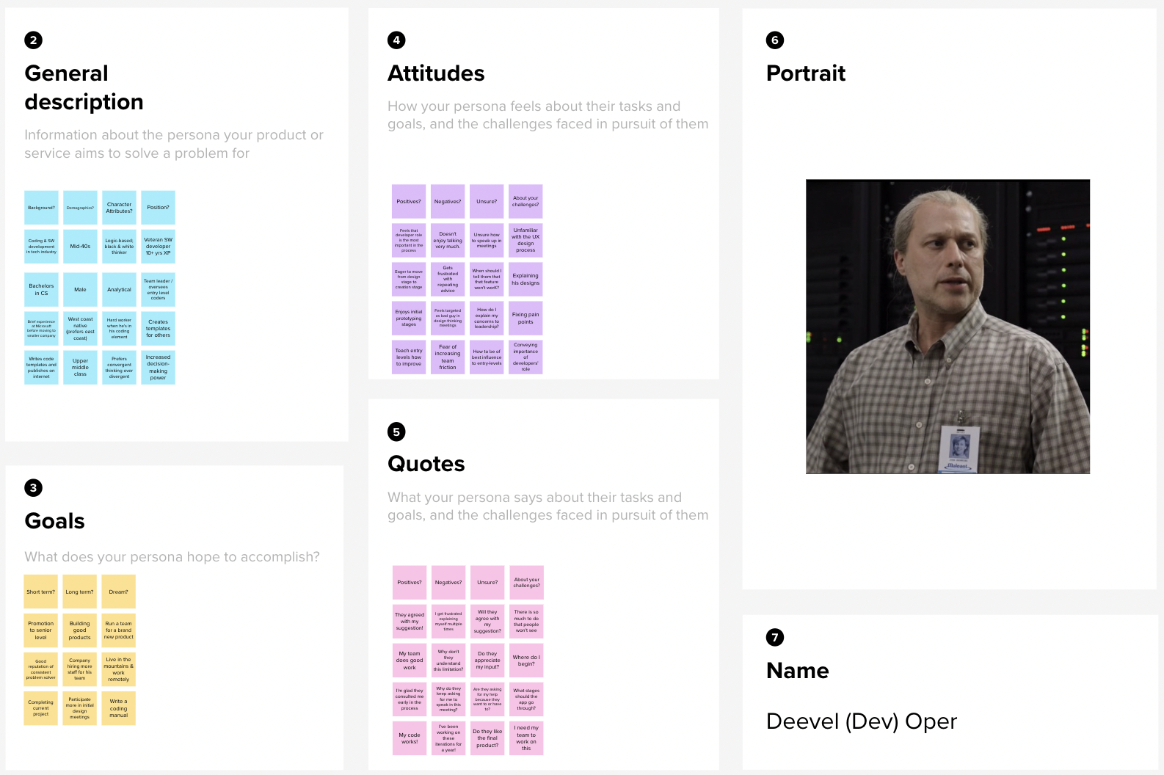
Initial Stages
Different roles
Different personalities
Different years of experience
Persona Profiles

Slide 5
Objective 2.0
Transform ITK into a collaboration tool that encourages and unifies participation across varying personas, like Dee and Dev, within the same project

Slide 7
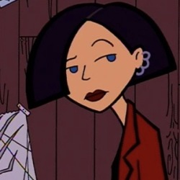
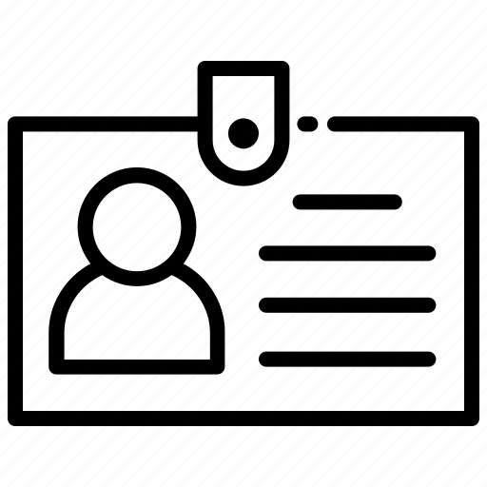
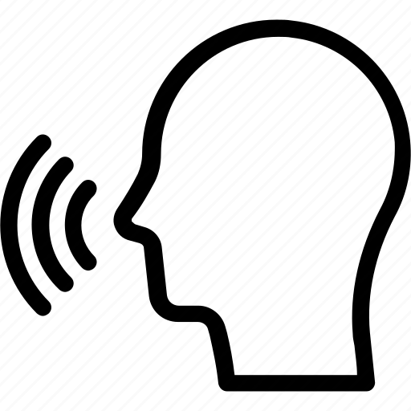
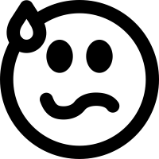
Persona 1
Recent graduate
Entry-level UX designer
Deandra (Dee) Ziner
Entry-level designer at the IRS
Very outgoing
Dee is working on redesigning the IRS Stimulus Check Portal.
She would like a convenient way to collaborate with developers and MITRE for this project.
Loves to think outside the box
At times feel intimidated to share her ideas

Slide 8
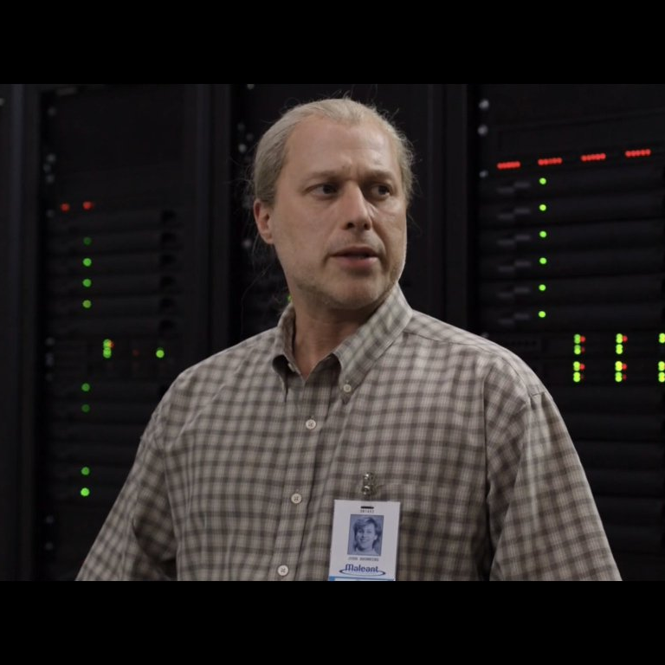
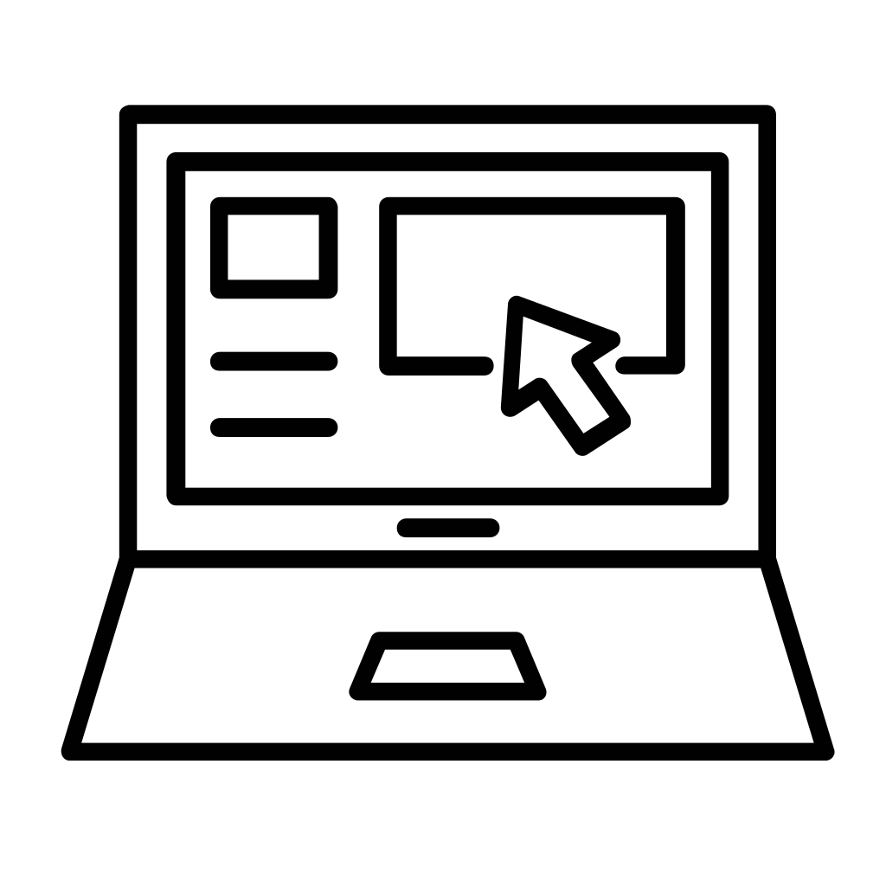
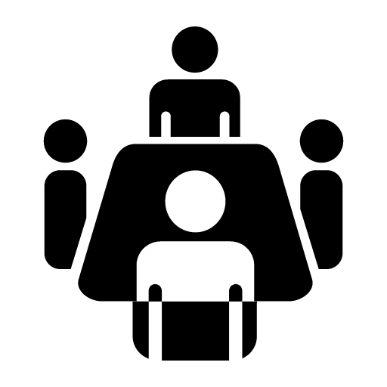
Persona 2
10+ years of industry experience
Deevel (Dev) Oper
Prefers to work alone
Sr. Developer at IRS
Tends to stay quiet during meetings
Dev is a developer for the project: redesigning the IRS Stimulus Check Portal.
During project meetings, he doesn’t like to actively voice his thoughts.
Frustrated when users do not understand product

Slide 9
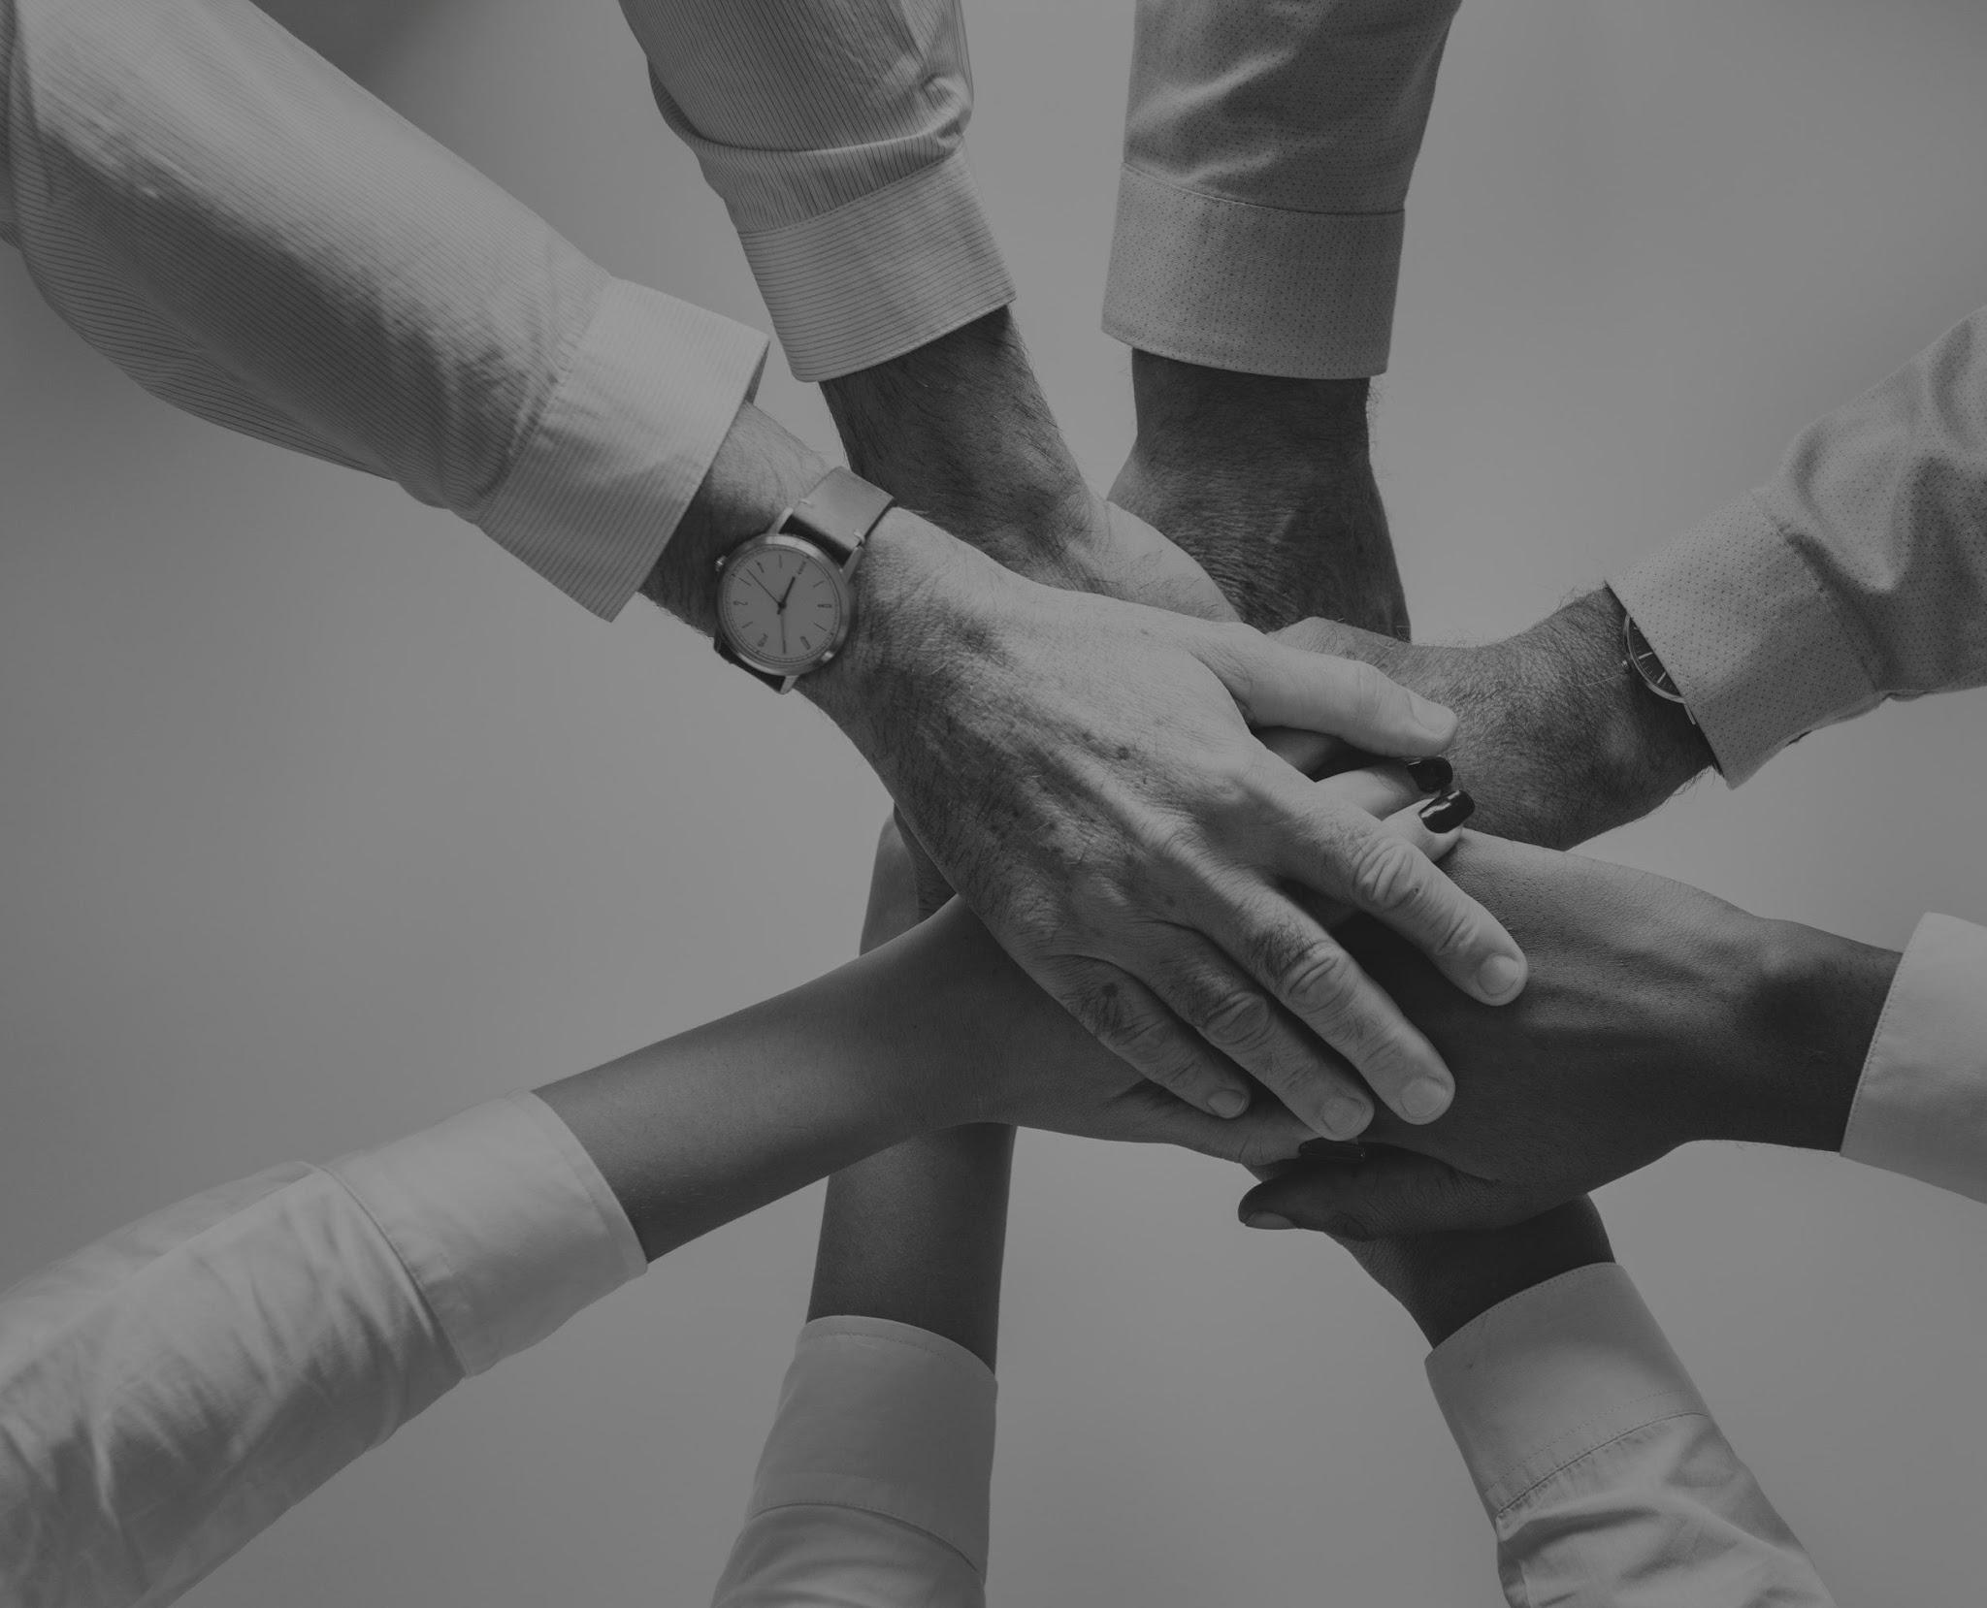
Dee Ziner's Objective Statements
"I want one place where I can organize all of my client projects"
"When I start a new project, I want to quickly browse through all of the tools to pick one to start with"
"I want the ability to add on tools to that project and create my own blueprint"
“I want to visually see how much I, and the others, have contributed to the tool.”

Slide 10
Dev Oper's Objective Statements
"Security is paramount, I hope the entry-levels take that seriously"
“I want to view each individual task of the tool, so I can focus all my energy on the current task.”
"I'd like see others' comments on ideas before I start any work"
"I don't need fancy formatting tools, just let me do Ctrl B!"

Slide 11
Demo: Create a new project

Slide 12
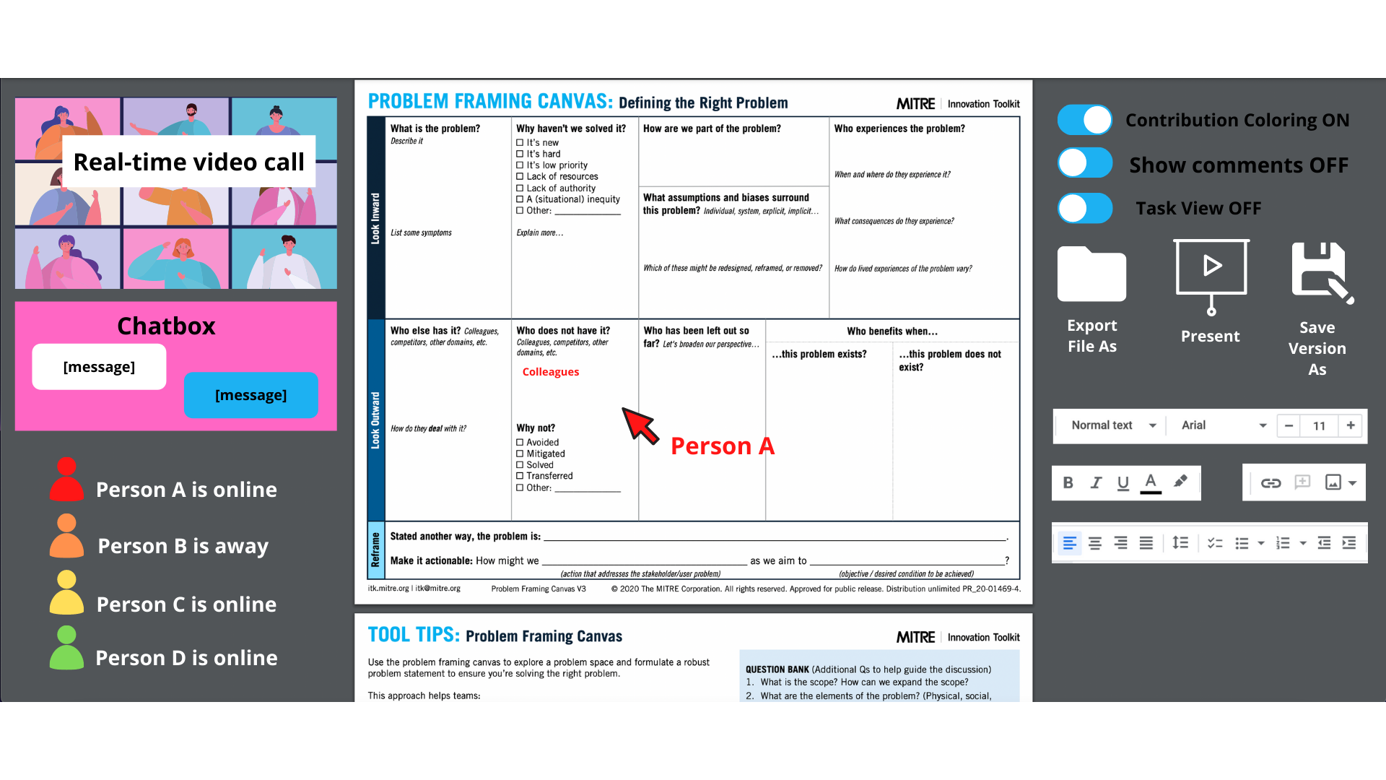
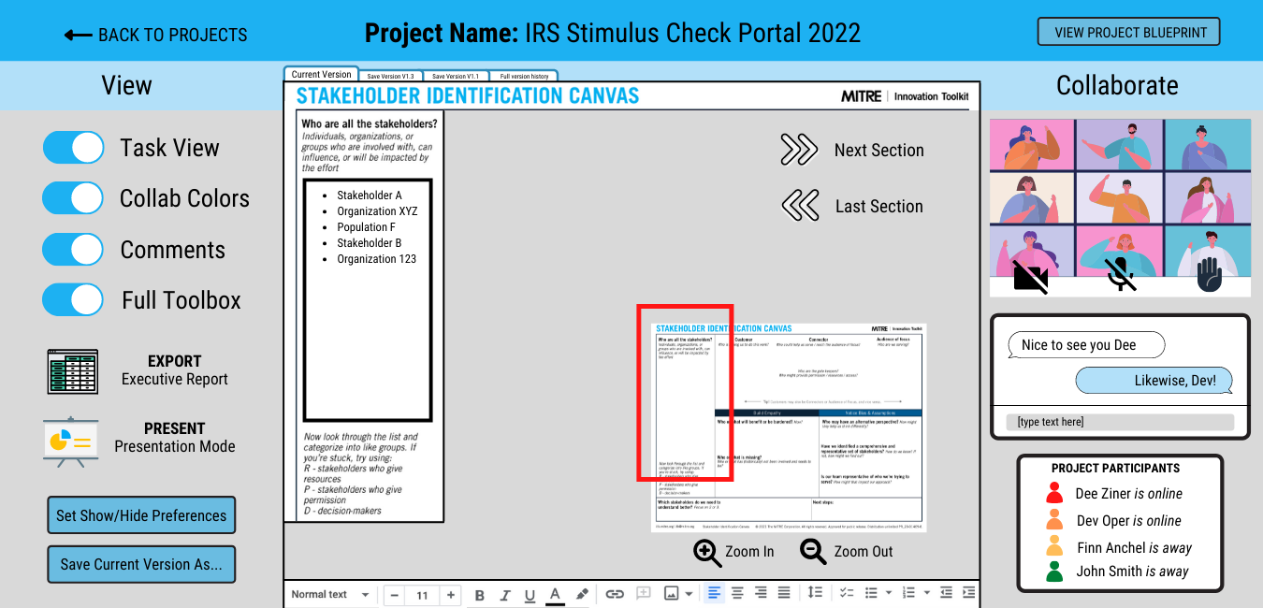
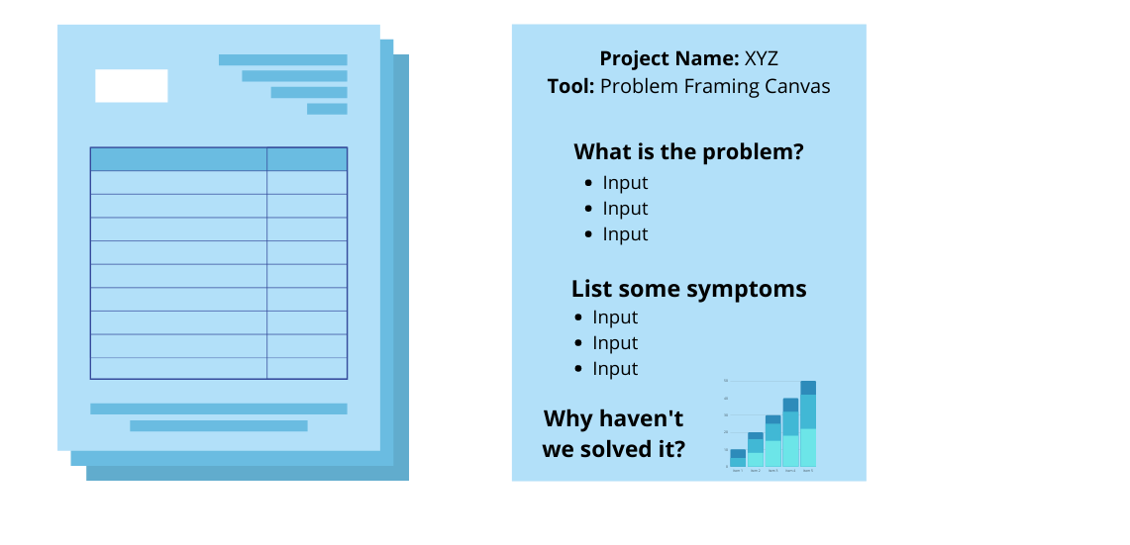
Iterations
Initial designs in Canva

Slide 13
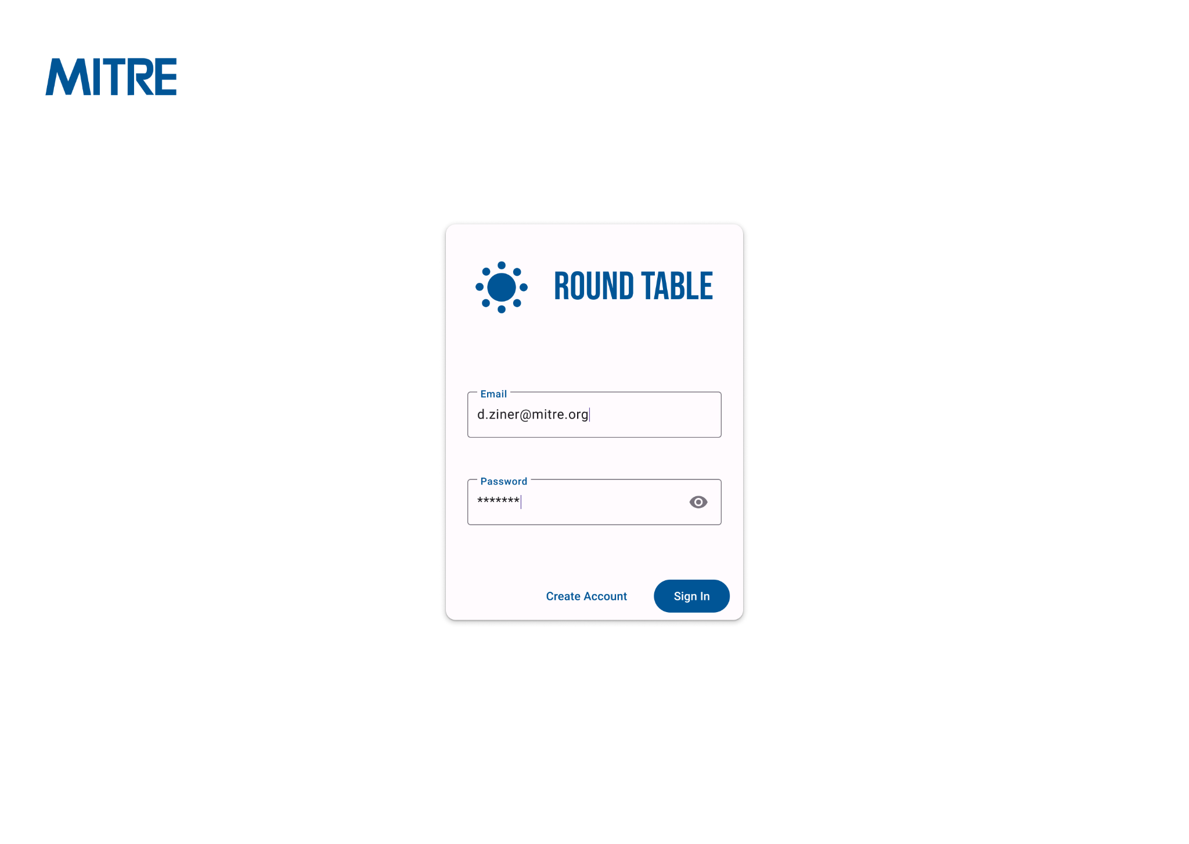
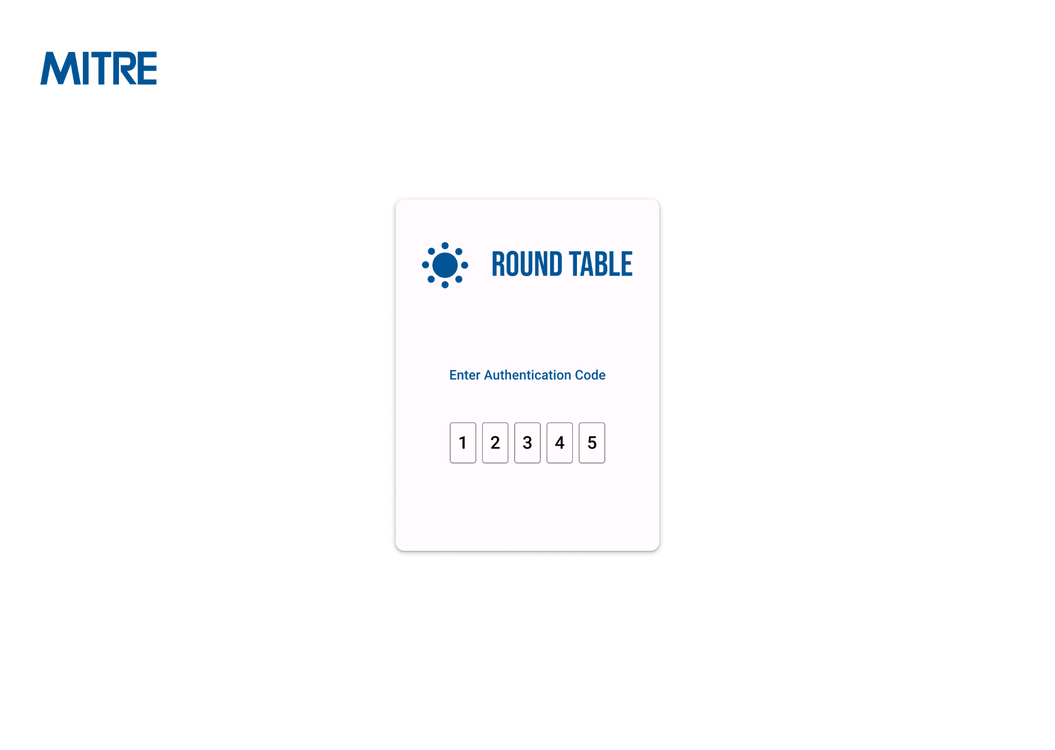
Iterations: Double-authentication
SECURITY
Double authentication to secure company’s confidential documents.

Slide 14
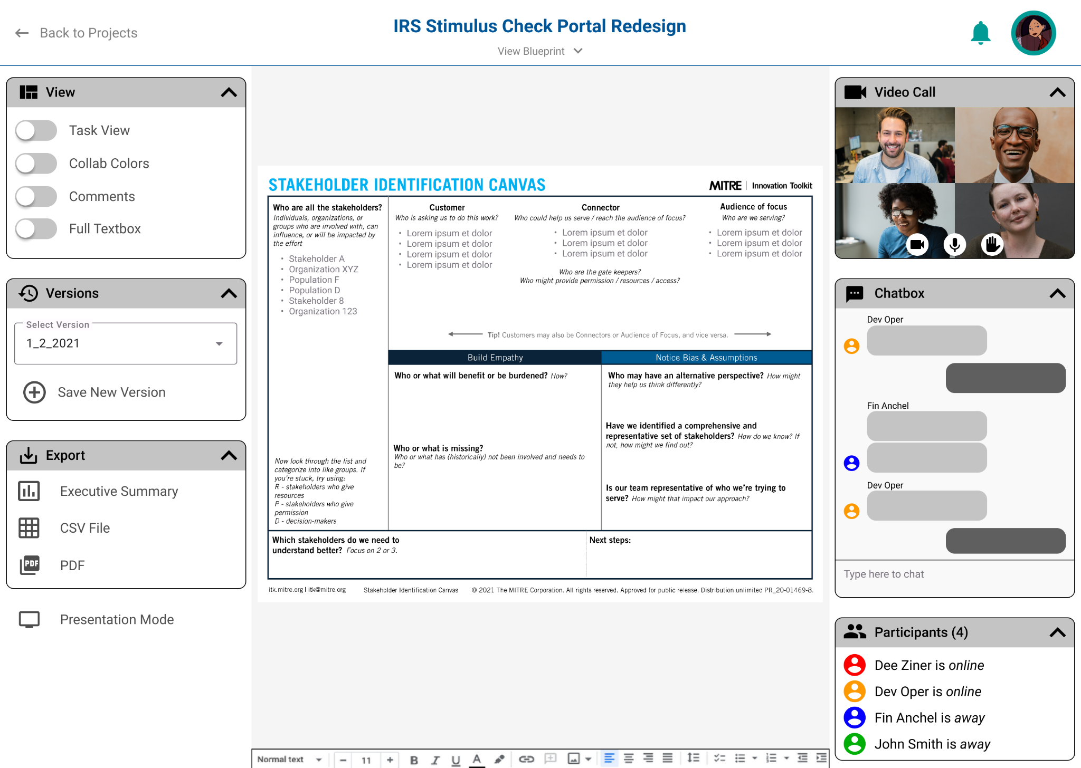
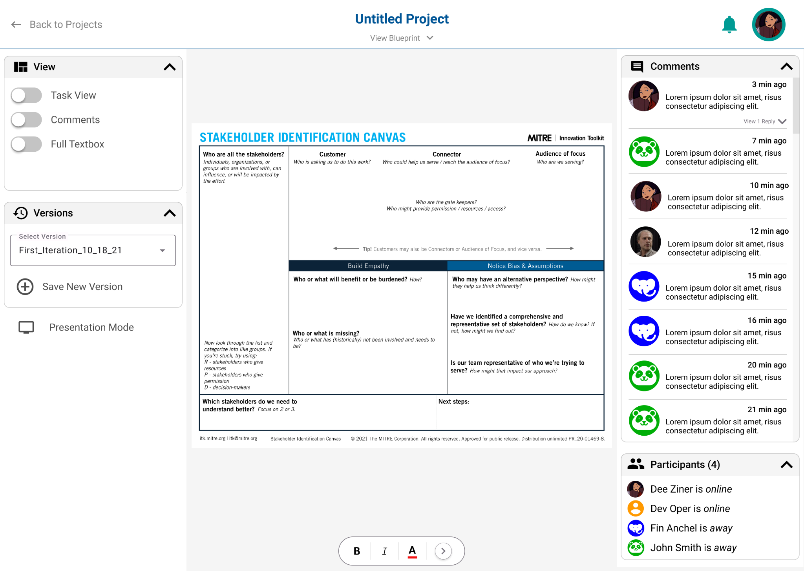
Iterations: Right-side modules
Stakeholder:
“We don’t want to re-create video call and chat box, there are existing tools.”
ORGANIZATION AND LAYOUT
Content of each comment is grouped into a different section for better readability.

Slide 15
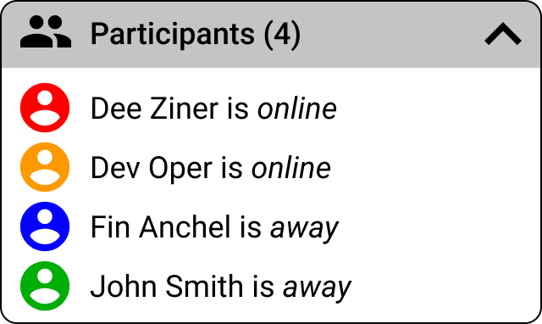
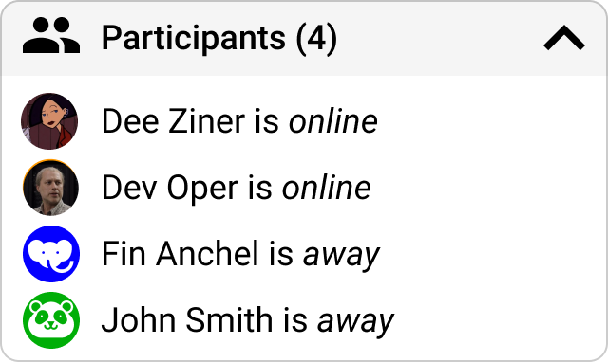
Iterations: Collaboration Icons
Stakeholder:
“If there are a lot of participants, lots of different colors will be used and might be hard for a person to differentiate.”
ICONOGRAPHY
Besides colors, icons are used as well to differentiate user’s contributions to tool.

Slide 16
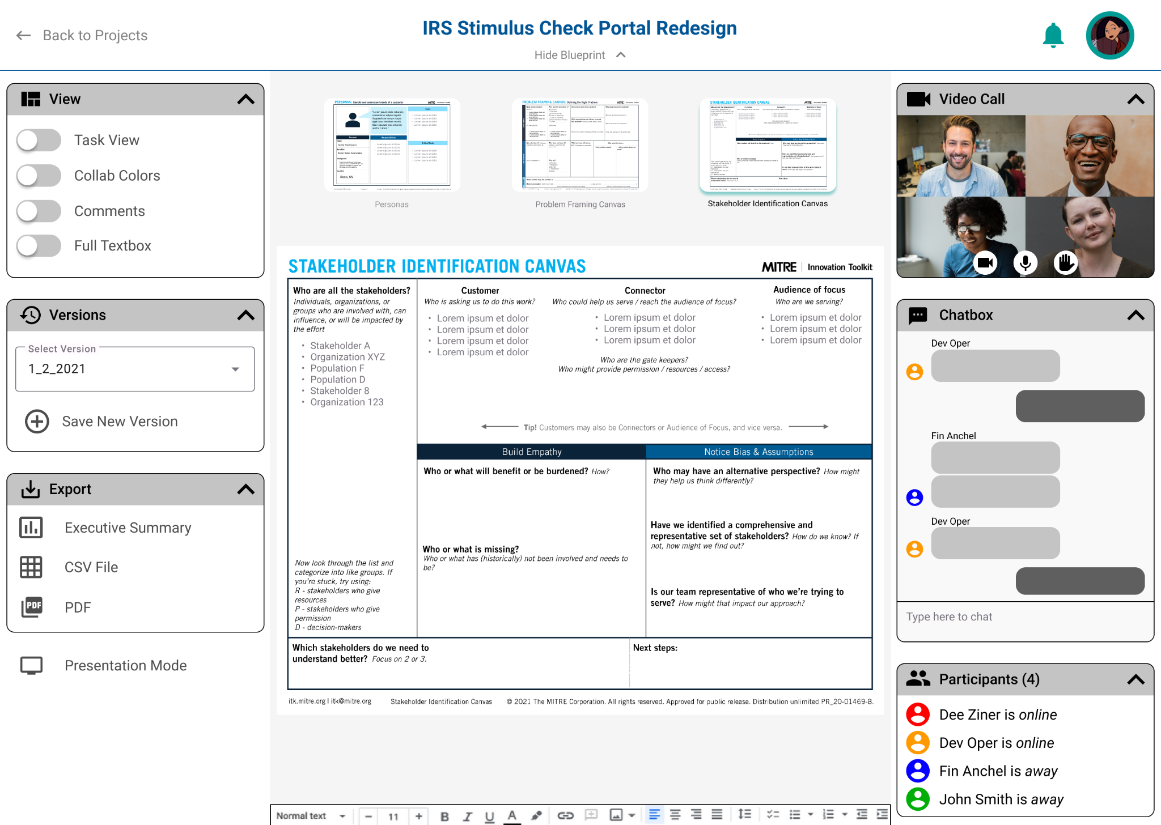
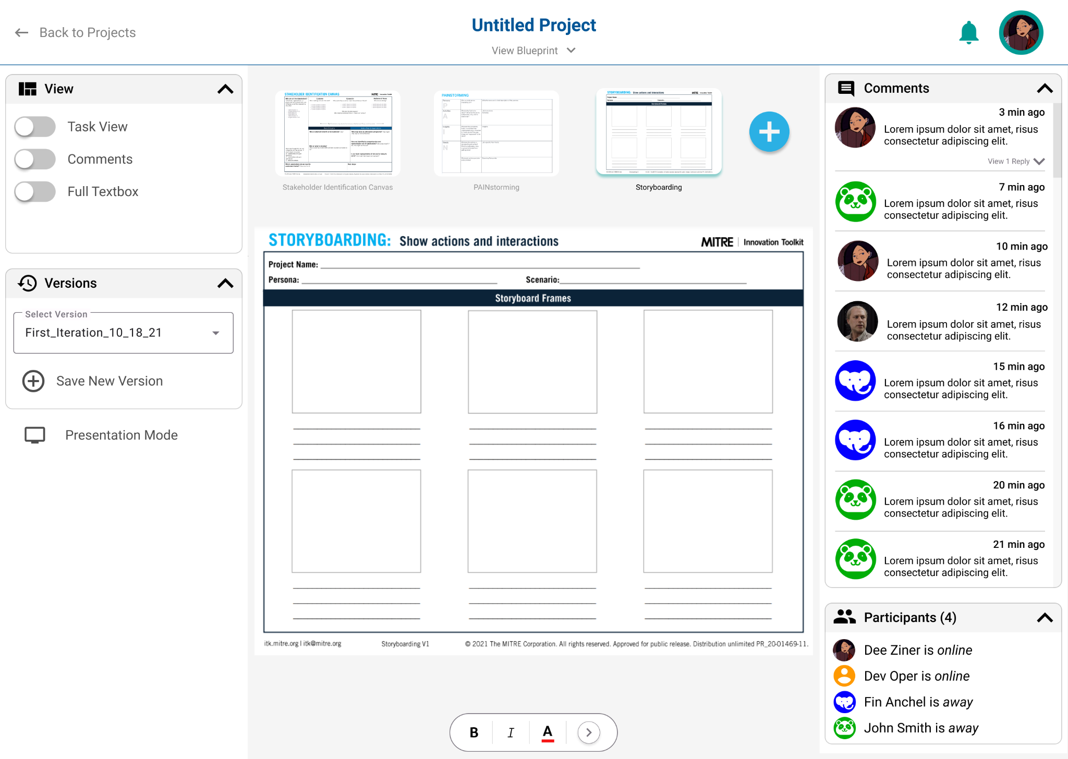
Iterations: Customize blueprints
CONSISTENCY AND CONTROLS
Button has on-brand color and allows user to customize blueprint with available tools.

Slide 17
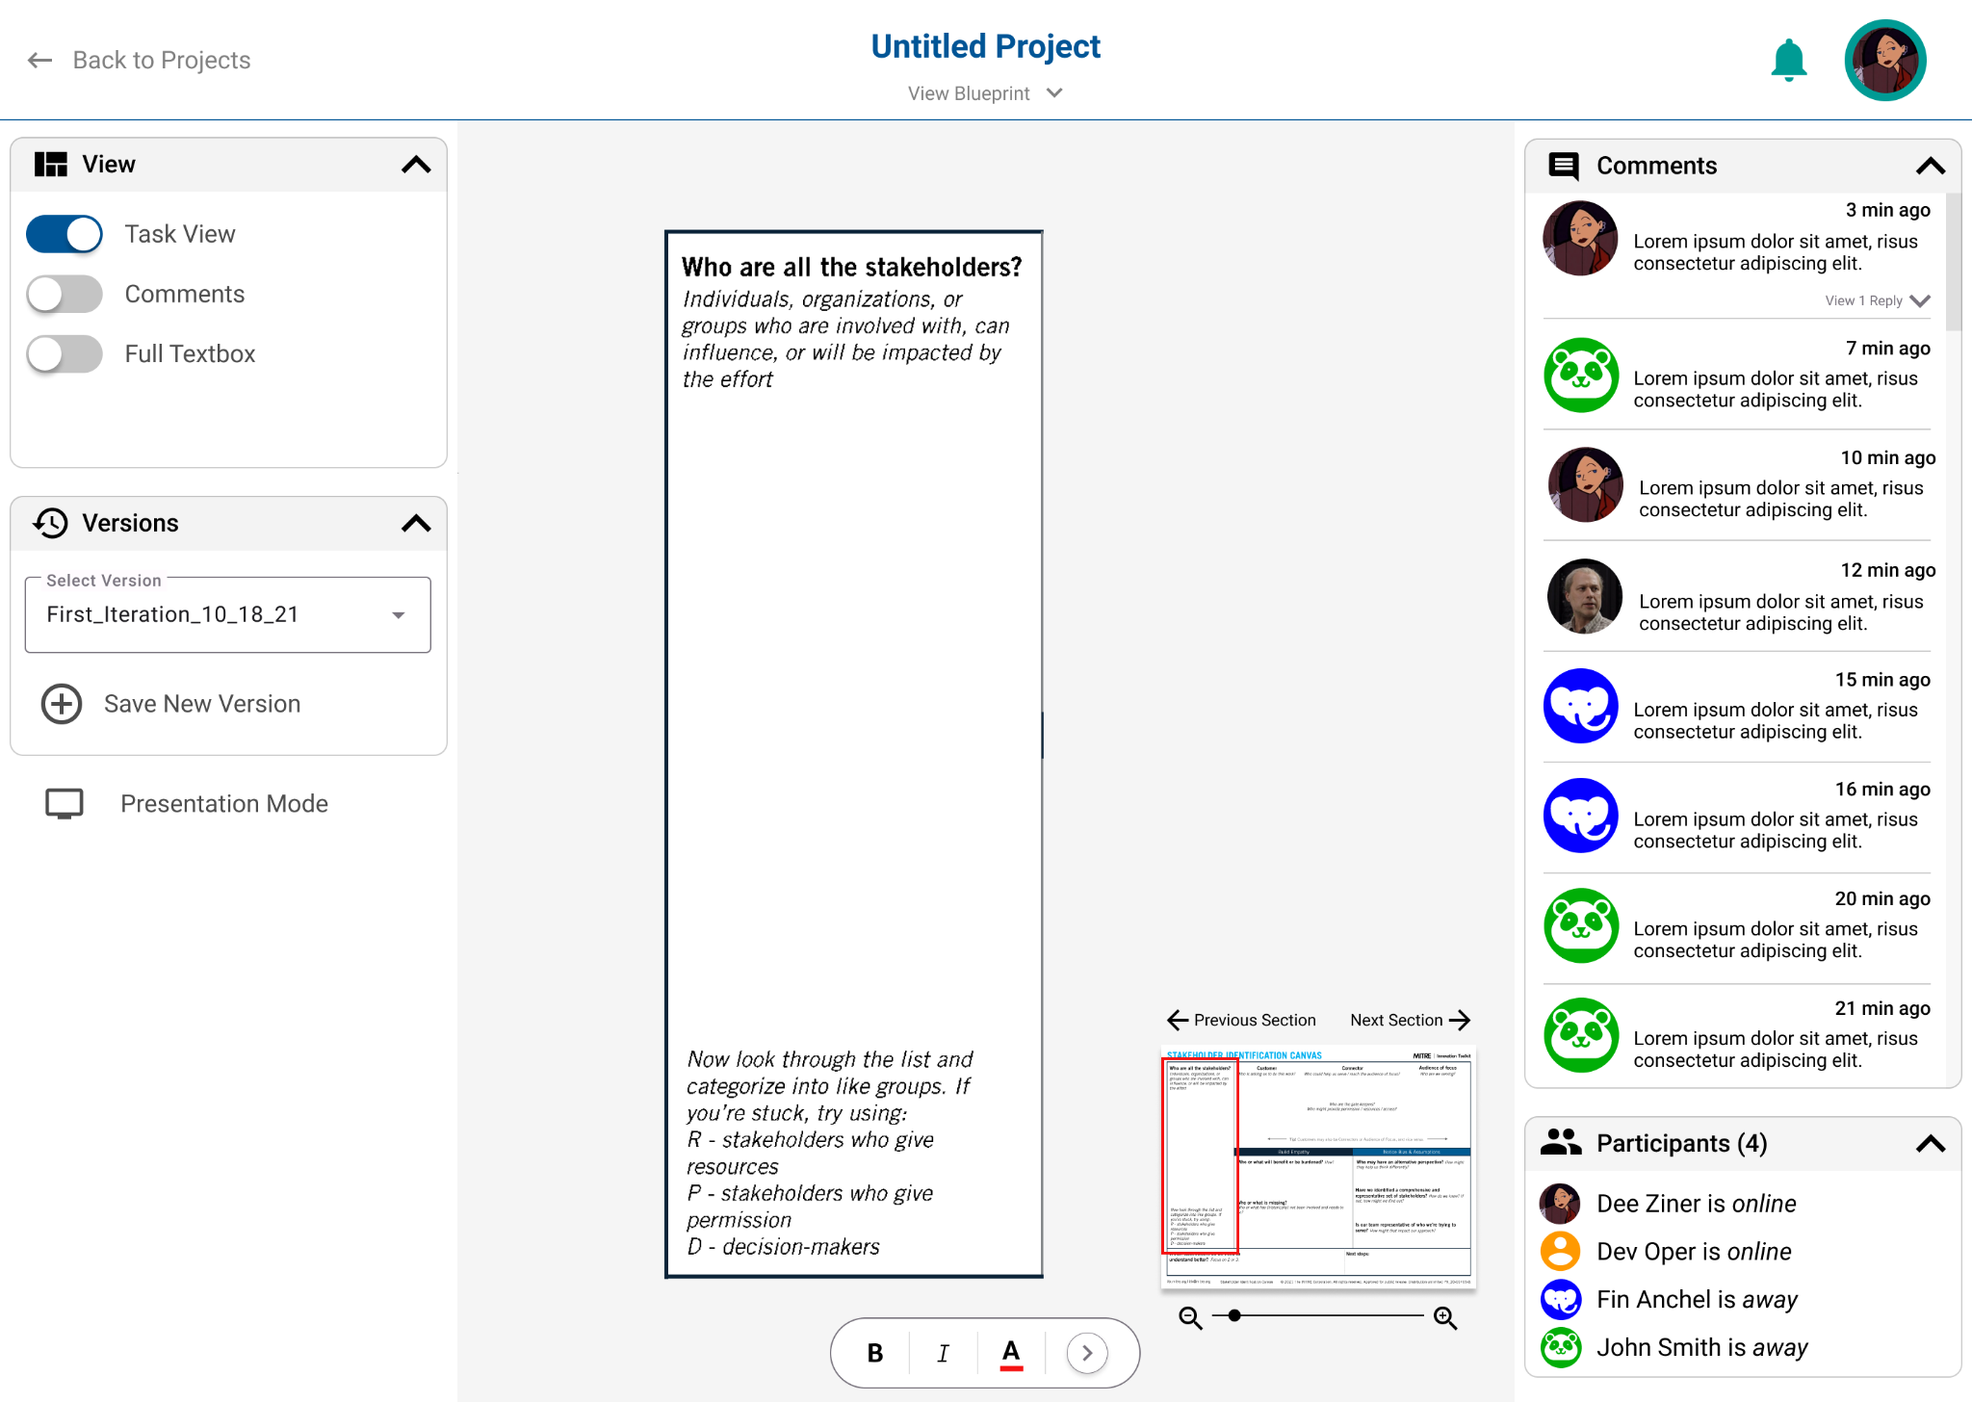
Iterations: Task View
NAVIGATION
User can zoom into one section of the tool and navigate through the sections with mini map.

Slide 18
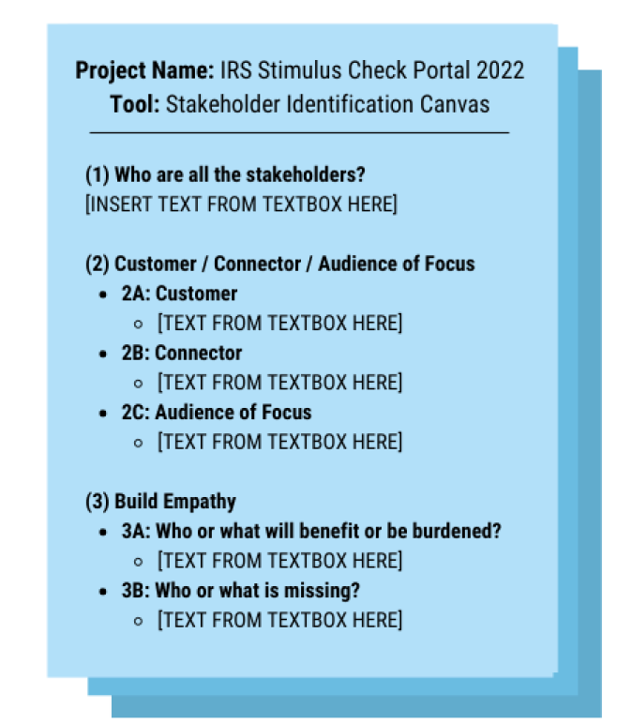
Iterations: Executive Summary
CONTROLS
Settings allow user to customize export format of executive summary.

Slide 19
Next Steps
Tutorial walkthrough of available features in the ITK platform
Premade blueprints for users who have a goal, but don’t know what tools to start with

Slide 20
Thank you!

Slide 21
Questions?

